Slide 1

Pizza Sales SQL Queries
Rishabh Bisht

Slide 2

KPI’s Queries

Slide 3

1. Total Revenue:
SELECT SUM(total_price) AS Total_Revenue FROM pizza_sales;

Slide 4

2. Average Order Value
SELECT (SUM(total_price) / COUNT(DISTINCT order_id)) AS Avg_order_Value FROM pizza_sales

Slide 5

3. Total Pizzas Sold
SELECT SUM(quantity) AS Total_pizza_sold FROM pizza_sales

Slide 6

4. Total Orders
SELECT COUNT(DISTINCT order_id) AS Total_Orders FROM pizza_sales

Slide 7

5. Average Pizzas Per Order
SELECT CAST(CAST(SUM(quantity) AS DECIMAL(10,2)) /
CAST(COUNT(DISTINCT order_id) AS DECIMAL(10,2)) AS DECIMAL(10,2))
AS Avg_Pizzas_per_order
FROM pizza_sales

Slide 8
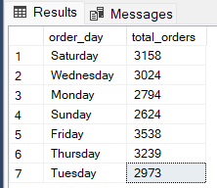
6. Daily Trend for Total Orders
SELECT DATENAME(DW, order_date) AS order_day, COUNT(DISTINCT order_id) AS total_orders
FROM pizza_sales
GROUP BY DATENAME(DW, order_date)

Slide 9
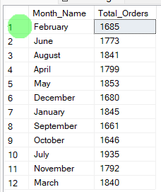
7. Monthly Trend for Orders
select DATENAME(MONTH, order_date) as Month_Name, COUNT(DISTINCT order_id) as Total_Orders
from pizza_sales
GROUP BY DATENAME(MONTH, order_date)

Slide 10
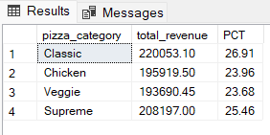
8. % of Sales by Pizza Category
SELECT pizza_category, CAST(SUM(total_price) AS DECIMAL(10,2)) as total_revenue,
CAST(SUM(total_price) * 100 / (SELECT SUM(total_price) from pizza_sales) AS DECIMAL(10,2)) AS PCT
FROM pizza_sales
GROUP BY pizza_category

Slide 11
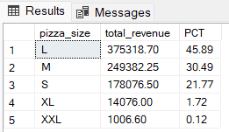
9. % of Sales by Pizza Size
SELECT pizza_size, CAST(SUM(total_price) AS DECIMAL(10,2)) as total_revenue,
CAST(SUM(total_price) * 100 / (SELECT SUM(total_price) from pizza_sales) AS DECIMAL(10,2)) AS PCT
FROM pizza_sales
GROUP BY pizza_size
ORDER BY pizza_size

Slide 12
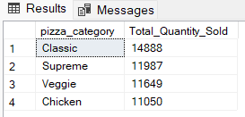
10. Total Pizzas Sold by Pizza Category
SELECT pizza_category, SUM(quantity) as Total_Quantity_Sold
FROM pizza_sales
WHERE MONTH(order_date) = 2
GROUP BY pizza_category
ORDER BY Total_Quantity_Sold DESC

Slide 13
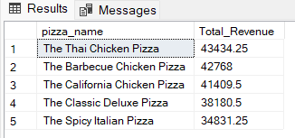
11. Top 5 Pizzas by Revenue
SELECT Top 5 pizza_name, SUM(total_price) AS Total_Revenue
FROM pizza_sales
GROUP BY pizza_name
ORDER BY Total_Revenue DESC

Slide 14
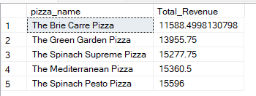
12. Bottom 5 Pizzas by Revenue
SELECT Top 5 pizza_name, SUM(total_price) AS Total_Revenue
FROM pizza_sales
GROUP BY pizza_name
ORDER BY Total_Revenue ASC

Slide 15
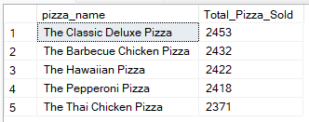
13. Top 5 Pizzas by Quantity
SELECT Top 5 pizza_name, SUM(quantity) AS Total_Pizza_Sold
FROM pizza_sales
GROUP BY pizza_name
ORDER BY Total_Pizza_Sold DESC

Slide 16
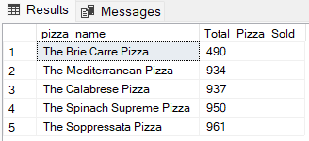
14. Bottom 5 Pizzas by Quantity
SELECT TOP 5 pizza_name, SUM(quantity) AS Total_Pizza_Sold
FROM pizza_sales
GROUP BY pizza_name
ORDER BY Total_Pizza_Sold ASC

Slide 17
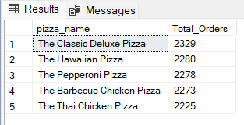
15. Top 5 Pizzas by Total Orders
SELECT Top 5 pizza_name, COUNT(DISTINCT order_id) AS Total_Orders
FROM pizza_sales
GROUP BY pizza_name
ORDER BY Total_Orders DESC

Slide 18
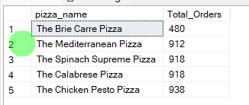
16. BoTTom 5 Pizzas by Total Orders
SELECT Top 5 pizza_name, COUNT(DISTINCT order_id) AS Total_Orders
FROM pizza_sales
GROUP BY pizza_name
ORDER BY Total_Orders ASC

